Slide 1


Digitalization
and the new workforce imperatives for Nashville
Mark Muro
Brookings Metropolitan Policy Program
Nashville
July 21, 2017
@MarkMuro1

Slide 2
1
Digitalization: What it is; why it matters
2
A new analysis and national trends
3
Nashville trends, implications

Slide 3
1
Digitalization: What it is; why it matters
2
A new analysis and national trends
3
Nashville trends, implications

Slide 4



Technological innovations are transforming our economy
Relentless pace of technological change
Rapidly changing business models
“Digitalization of everything”
Notes:
Edit economy overview slide with a more digital image (more guidance coming)

Slide 5




What we mean by “digitalization”
Digitalization is the process of employing digital technology and data to transform business operations and create value
Notes:
What is “digitization?”
Digital as general purpose technology
Pervasive, transformative—info from Brynjolffssen, McKinsey, Brandstetter coming

Slide 6


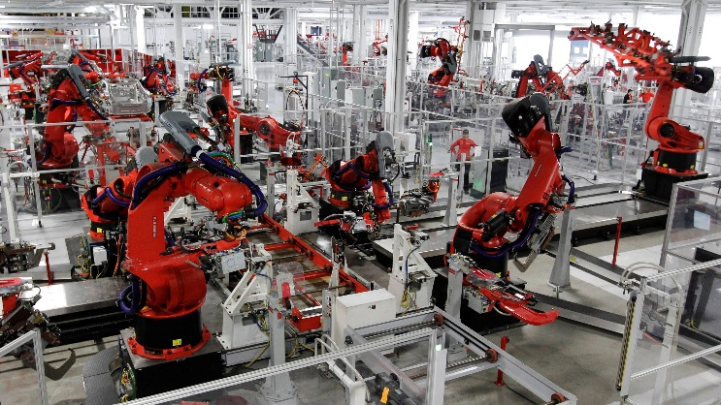


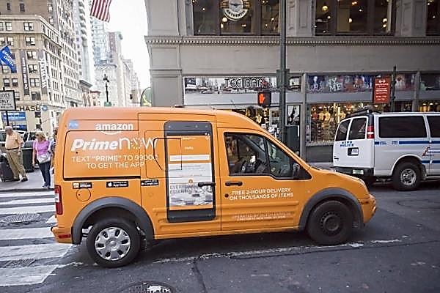

An explosion of digital tools is transforming nearly every industry
Notes:
Headline: An explosion of digital tools is transforming almost every industry
Left (tools): (Can ask Dustin for photo or other research)
Microsoft Office logo
Salesforce logo
Amazon Web Services image or logo
Image of a phone running an app
Image for artificial intelligence (small block of 0s and 1s?)
Right: Images or logos for industry change
Robotic mfg (Tesla factory)
Amazon same-day delivery in retail (pic of Amazon truck)
Ride-sharing (Uber)
Health IT
Education online (MOOCS)

Slide 7
Challenges include an IT skills gap and limited overall digital proficiency
1 in 6
working-age Americans are unable to use email, web
search, or other basic online tools
100,000
60,000
Source: BLS Presentation, 2016
Source: OECD

Slide 8
1
Digitalization: What it is; why it matters
2
A new analysis and national trends
3
Nashville trends, implications

Slide 9


How we studied digitalization
Comprehensive digitization score from 1 to 100
Two categories of O*NET digitalization data
545
occupations
Software Developers, | 94
Computer Systems Analysts | 79
Lawyers | 58
Mechanics | 55
Registered Nurses | 55
Security Guards | 31
Restaurant Cooks | 18
Construction Laborers | 17
Personal Care Aides | 14
Knowledge of Computers and Electronics
Interaction with Computers
91%
of the U.S.
labor force

Slide 10









We sorted occupations by high, medium, & low digital requirements
High
(digital scores above 60)
Medium
(digital scores between 33 and 60)
Low
(digital scores below 33)
Software Developers
Financial Managers
Lawyers
Registered Nurses
Security Guards
Restaurant Cooks
Computer Systems Analysts
Market Research Analysts
Automotive services Technicians and Mechanics
Office Clerks
Construction Laborers
Personal Care Aides

Slide 11


The share of jobs requiring high & medium digital skills has skyrocketed
Share of U.S. employment by digital skill level
Administrative support
39
64
Tool & die makers
3
51
Notes:
National change over time

Slide 12
New jobs increasingly require high digital skills
Jobs created in the United States between 2010-2016, by digital score
Only 1/3 of U.S. jobs created since 2010 are attainable for workers with low digital skills

Slide 13
Highly digital industries have driven U.S. productivity growth
Annualized Productivity Growth by Sector, 2010 - 2016
Oil & Gas Extraction
Information technology
Media
Wholesale trade
Management of businesses
Retail Trade
Healthcare Services and Hospitals
Finance
Educational Services
Mining
(except Oil & Gas)
Notes:
National change over time

Slide 14
Digitalization corresponds to higher wages, even controlling for education
Average annual wage by digital score, 2016
Notes:
National change over time

Slide 15
Higher-paying industries tend to have higher digital scores
Share of sector employment by digital score, 2016
Higher paying
Lower paying

Slide 16
Yet women remain underrepresented in highly digital occupations
Higher digital score
US Average
Lower digital score

Slide 17
Workers of color are disproportionately employed in low-digital skill jobs
Higher digital score
US Average
Lower digital score

Slide 18


Good jobs for workers without college degrees are rapidly digitizing
Digital scores of select “opportunity jobs” occupations
29
“Opportunity jobs”
digital score in 2002
Table 3
Truck & tractor operators
2
33
50
“Opportunity jobs”
digital score in 2016
Registered Nurses
38
55

Slide 19
1
Digitalization: What it is; why it matters
2
A new analysis and national trends
3
Nashville trends, implications

Slide 20
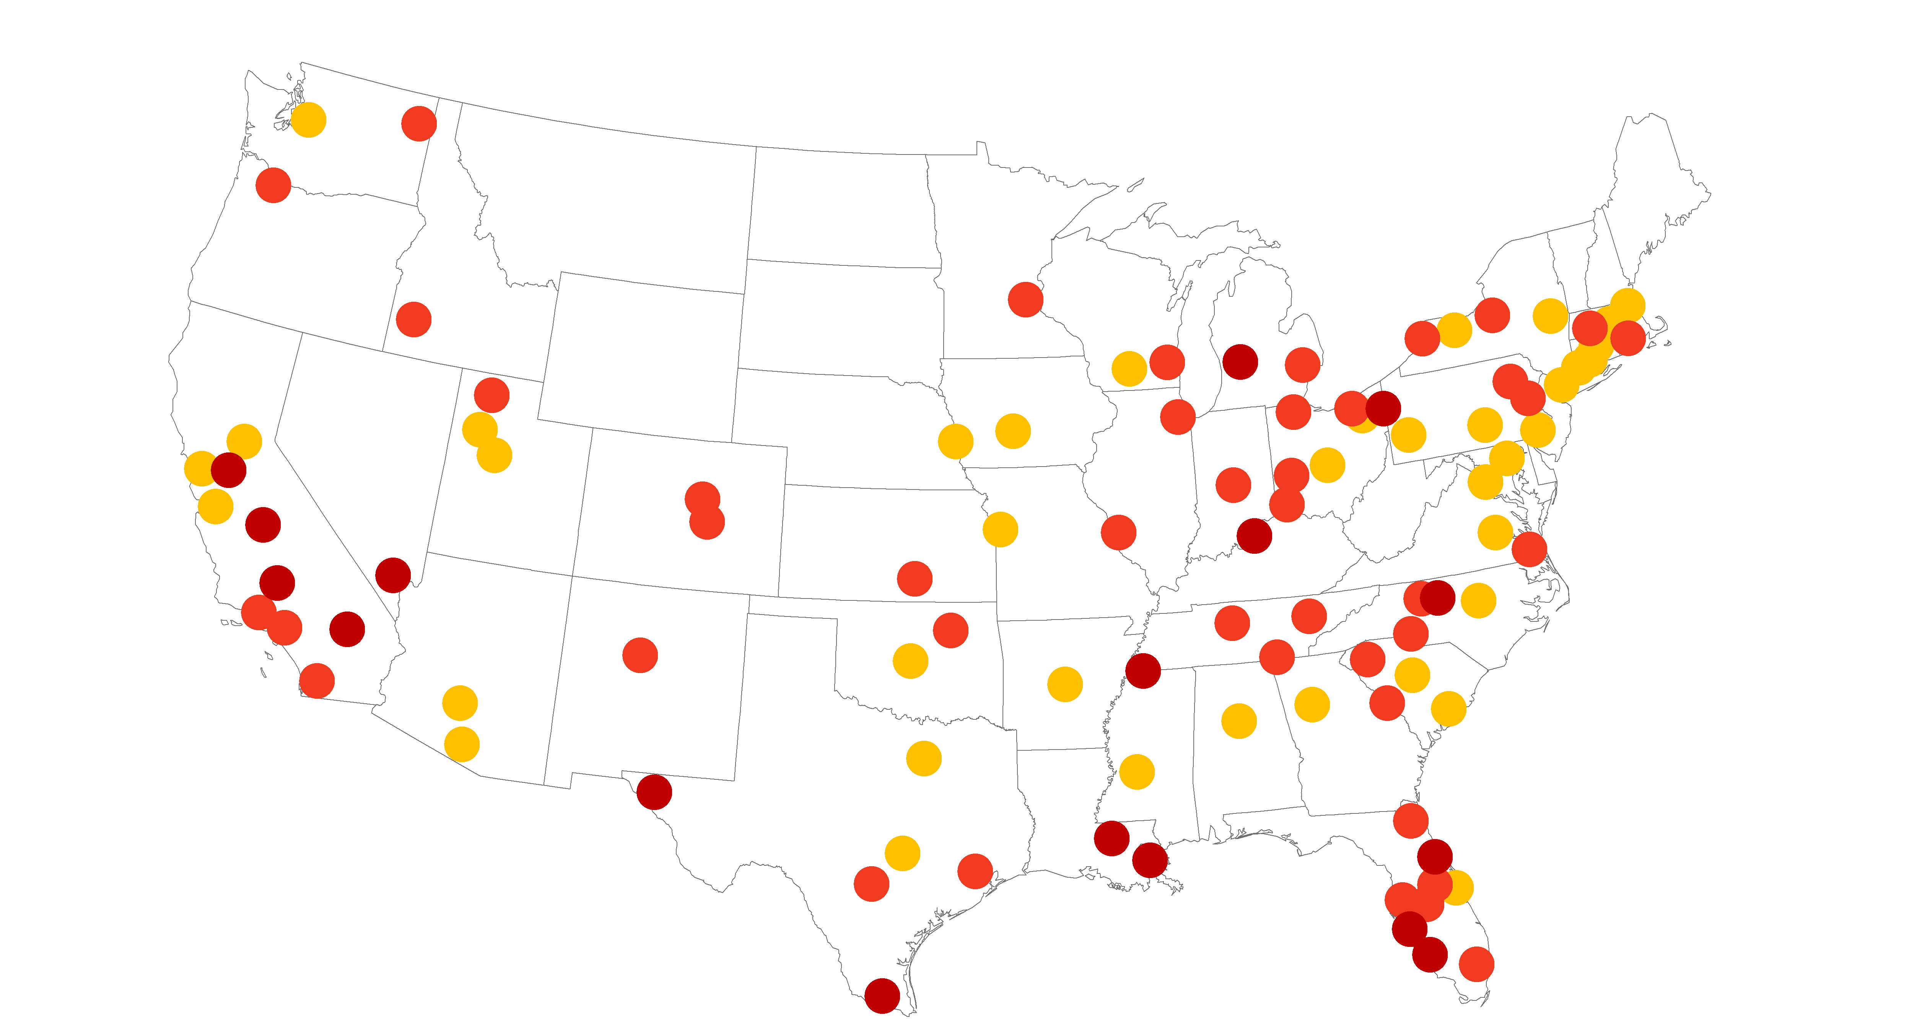
Digitalization levels vary across U.S. metros
Average digital score by metro area, 2016
Digital level
41 - 47
39 - 41
36 - 39
Nashville
Note: MSA digitization scores are calculated as the average score of occupations, weighted by employment
Notes:
22. Improve the labeling on the map.
Should Indianapolis be bigger; should it be out on the blue ground with a longer arrow?

Slide 21
Higher metro digitalization is strongly correlated with higher wages
San Jose
San Francisco
Bridgeport
Boston
Stockton
Las Vegas
McAllen
Nashville
Note: MSA digitization scores are calculated as the average score of occupations, weighted by employment
Notes:
Label a few of the MSAs; also, make the legend bigger and the dots bigger

Slide 22

Nashville maintains a middling median digital score
41
Nashville MSA
digital score
60th
Highest among the
largest 100 U.S. metros
Nashville Metropolitan Area
24%
of all employment
is highly digital
227,000
Highly digital jobs in 2016

Slide 23
However, few large metros are digitalizing as fast as Nashville
Employment in Nashville MSA by digital skill level
24
Digital score, 2002
41
Digital score, 2016
14th
Upskilling rank among
largest 100 U.S. metros
Notes:
21.
Left panel: Display 2002 and 2016 median digital scores with arrow pointing from 02 to 16
Sub for “76^{th”} the region’s ranking for score change and label as:
Upskilling rank among largest 100 metros

Slide 24
Nashville digitalization scores highlight two distinct issues
Advanced Industry Occupations
Opportunity Jobs
Note: “Opportunity jobs” are occupations that do not require a bachelor degree but pay higher than mean annual wage in Nashville in 2016
Notes:
24. For Indy, we need to play off an omnibus “advanced industries” sector (rather than the IT sector) against opportunity jobs. To build an advanced sector profile, we will pull from representative, larger occupations within:
Auto
Engineering
IT
Household appliances
Likewise, for the good jobs right-hand set of bars on the right, we can use the same list and bars you’re making for Indy—the MSA has a lot of the same look:
RNs
Supervisors of Production workers
Sales representative for technical and scientific products
Tool and die makers
Plumbers
Firefighters
Dental hygenists
Telecom line installers
Radiologic technologists
Physical therapist assistants
Electrical and electronics technicians
Computer numerically controlled machine programmers

Slide 25
Occupations in Nashville’s advanced industries are rapidly digitalizing
Digital skill ratings for large IT occupations in Nashville
Notes:
25. Create new slide showing fast growth of key, larger, big changing occupations’ digital scores in auto along lines of existing good jobs slide
Show me candidate occupations; want to reality test them against things I’ve heard them talk about and my own knowledge

Slide 26
Occupations in Nashville’s advanced industries are rapidly digitalizing
Digital skill ratings for large auto occupations in Nashville
Notes:
25. Create new slide showing fast growth of key, larger, big changing occupations’ digital scores in auto along lines of existing good jobs slide
Show me candidate occupations; want to reality test them against things I’ve heard them talk about and my own knowledge

Slide 27
On-ramps to middle-class careers are rapidly upskilling
Digital skill ratings for key “opportunity jobs” in Nashville
Notes:
28. FIX
Supervisors of Production workers
Sales representative for technical and scientific products
Tool and die makers
Plumbers
Firefighters
Dental hygenists
Computer numerically controlled machine programmers
Telecom line installers
Radiologic technologists
Physical therapist assistants
Electrical and electronics technicians

Slide 28



Nashville should adopt two digital workforce training priorities
1.
Expand and widen the high-digital IT talent pipeline
2.
Increase basic digital literacy, especially among underrepresented groups

Slide 29
Nashville should adopt two digital workforce training priorities
Invest in upskilling incumbent workers
Expand work-based learning
Align and scale up education and tech training
Provide top-flight career on-ramps
1.
Expand and widen the high-digital IT talent pipeline

Slide 30
Nashville should adopt two digital workforce training priorities
Launch compelling digital literacy campaigns
Facilitate broader exposure to basic office productivity software
Scale-up hands-on digital experiences
2.
Increase basic digital literacy, especially among underrepresented groups

Slide 31
Finally: Cultivate what is “uniquely human”
Emphasize adaptability, creativity, continuous learning, and social skills over rote information processing

Slide 32

For more information:
Mark Muro
Senior Fellow
Metropolitan Policy Program at Brookings
mmuro@brookings.edu
@markmuro1

Slide 33
Digitalization
and the new workforce imperatives for Nashville
Mark Muro
Brookings Metropolitan Policy Program
Nashville
July 21, 2017
@MarkMuro1

